Slide 1
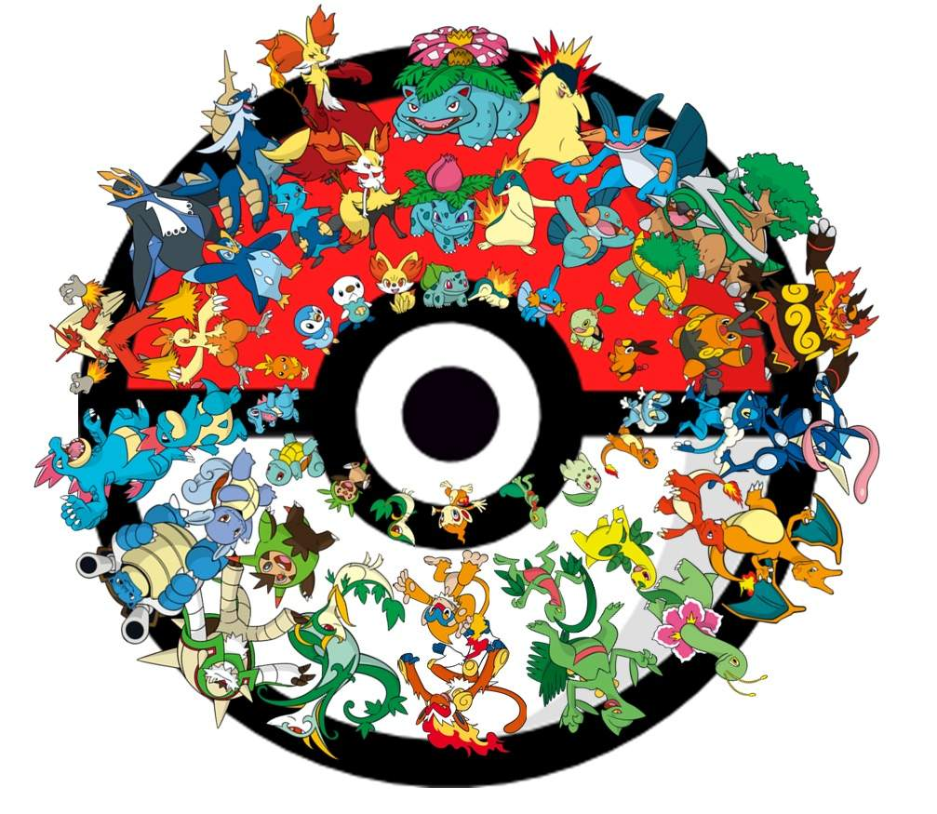
Top Pokemon
By
Omar Hussain

Slide 2
Overview:
What pokemon are going to be used the most
Not competitively but overall use. What pokemon are most popular for every kind of player
Goals:
Use Classification models to predict the popular pokemon.
Identify what makes a pokemon get the most usage.

Slide 3
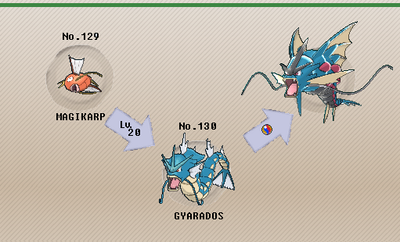
Process:
Gather Relevant Data
Create values for different classes of Pokemon.
EDA
Get a good understanding of my features.
Fit data into Classification Models
Bagging, XGBoost, and Random Forest.

Slide 4
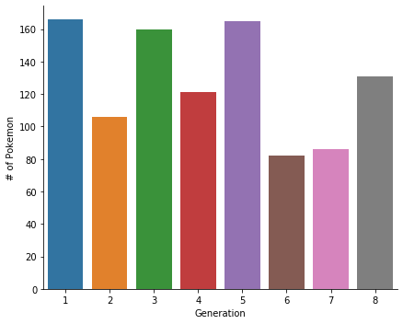

The Data
Data gathered from Kaggle:
Thomas Legrand: Data Scientist in Evry, France
1017 Pokemon with 721 base pokemon and 296 different forms
8 Different Generations
Top used Pokemon obtained from pokemon.neoseeker.com

Slide 5
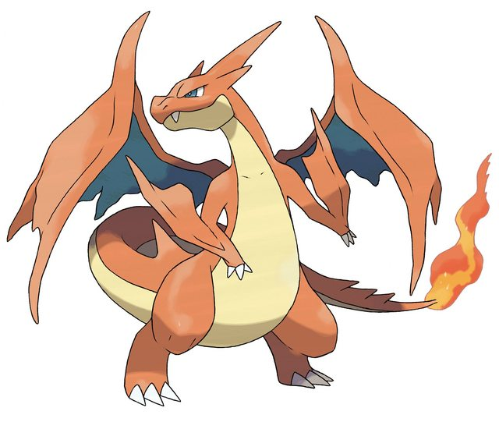
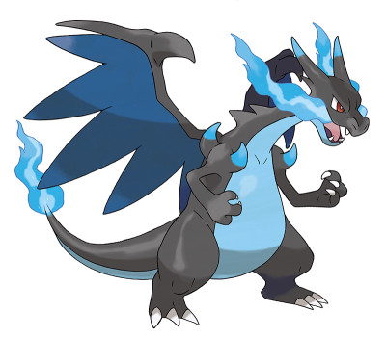
Models
Before GridSearch
Bagging Ensemble:
F1 score of .41
Accuracy of .91
XGBoost:
F1 score of .46
Accuracy of .91
Random Forest:
F1 score of .32
Accuracy Score of .89
After GridSearch
Bagging Ensemble:
F1 score of .24
Accuracy of .90
XGBoost:
F1 score of .52
Accuracy of .92
Random Forest:
F1 score of .56
Accuracy Score of .89

Slide 6
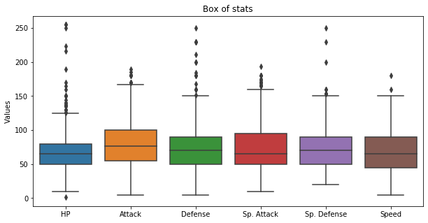
Stat Importance
Major outliers:
HP
Defense
Special Defense
Everything is well balanced for Game Mechanics

Slide 7
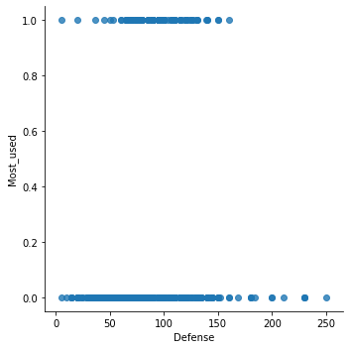
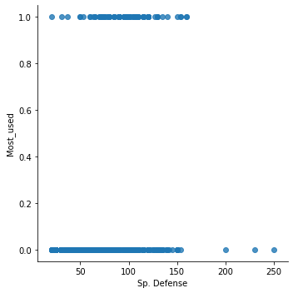
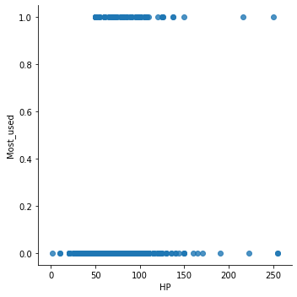
No Reason For Defenses
Pokemon with the highest HP, Defense, and Special Defense are not most used. Pokemon that fall into the Most Used are in the middle to account for High Attack, Special Attack, and Speed

Slide 8

Findings and Applications
Major Findings in determining how much people will use certain Pokemon
Most people will use Pokemon with higher Attack and Special Attack rather then Hit Points, Defense and Special Defense
Mega Pokemon and Legendary Pokemon are most used.
Applications
Predicting if a Pokemon is going to be commonly used in any new upcoming Pokemon Game, and Fan Made Pokemon Games.
Application to other games that are Stat based to determine most used characters when developing and new games.

